Slide 1
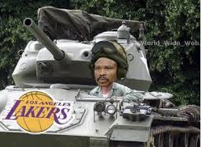
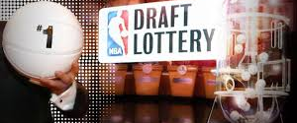

Proposal For NBA Draft Lottery Reform
Ben Tjiang

Slide 2
https://www.youtube.com/watch?v=8jaXcXsJUIM

Slide 3
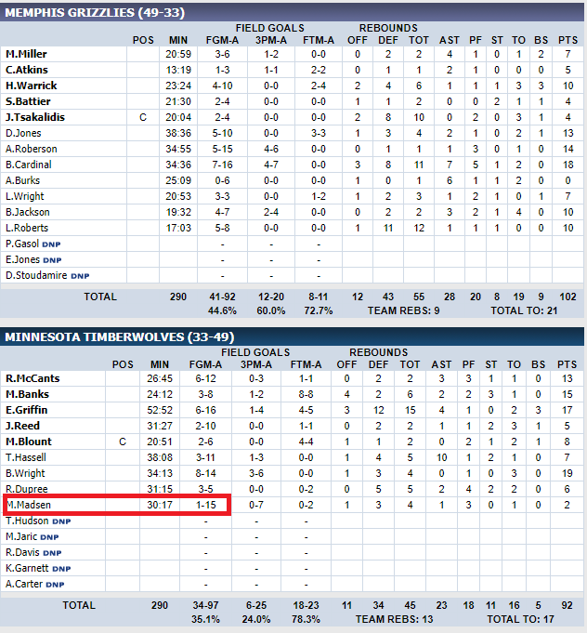

Slide 4
Why are teams tanking?
Incentives structure is flawed
League is built around superstar players
Salary cap system
Playoffs leave little to chance

Slide 5
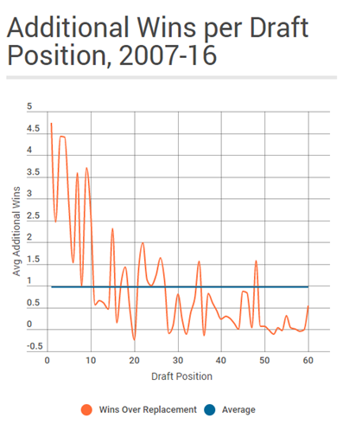

Slide 6
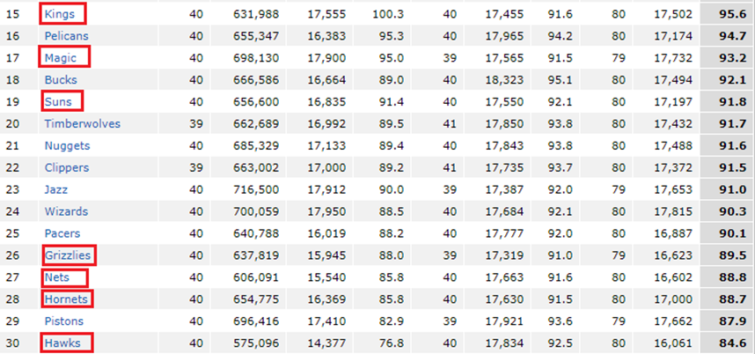

Slide 7
Proposed Solution
Restructure
Restructure lottery odds for non playoff teams
Shorten
Shorten the first round of the playoffs to five games, new playoff structure is 5-7-7-7.
Remove
Remove incentives for losing and add incentives for competing

Slide 8
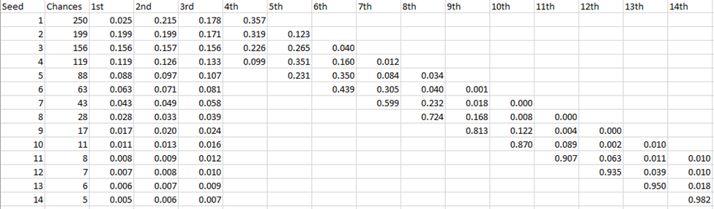
Current Lottery Odds

Slide 9
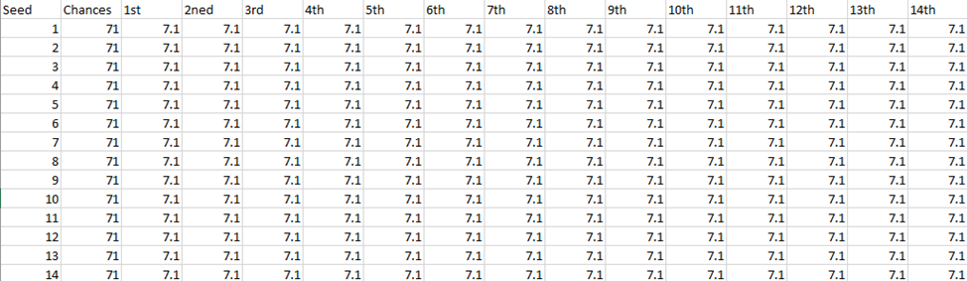
Proposed Lottery Odds

Slide 10
Alternative Proposed Solutions
Snake Draft
1
Do nothing
2
Maintain first iteration of changes
3

Slide 11
Implementation Plan
Maintain
Maintain current proposal lottery odds for 2018-2019 season along with current playoff structure
Inform
Inform teams of new proposed lottery odds for 2019-2020 season and foreseeable future along with new playoff structure. The new playoff structure is the same except for a five-game series in the first round instead of seven.
Enact
Enact new lottery odds and playoff structure for the 2019-2020 season and beyond.

Slide 12
Task | Date | Description
2018 NBA Draft Lottery with Current Odds | May 15, 2018 | Draft lottery is conducted as previously planned, with worst team having a 25 percent chance at the top pick and decreasing from there
2018-2019 NBA Draft (Current Lottery Odds) + Offseason | June 21, 2018 | Conduct 2018 NBA Draft as planned, teams can trade picks and players as normal
2019-2020 NBA Season | October 17, 2018 – April 11, 2019 | Play out the regular season as normal with the info in hand that lottery odds are slightly changed, bottom 3 teams have same odds at the top pick and decreasing from there. This is done to maintain the plan that was already in place to protect teams and their plans.
2019 NBA Draft Lottery with Slightly Altered Odds | May 15,2019 | Draft lottery is conducted with the reduced odds for the worst teams.
2019-2020 NBA Draft (Slightly Altered Lottery Odds) | June 21,2019 | Last draft with heavy lottery odds for worst teams is conducted the same, owners and gm’s already informed that draft lottery odds will change in future.
Inform Teams of New Lottery Odds and Playoff Structure | June 25, 2019 | Announce the new lottery odds and five game playoff series structure for first round. This is done before free agency and rookie contracts are signed so that teams have ample time to adjust their plans
2020-2021 NBA Offseason | June 25, 2019 | Offseason continues as planned for league and teams
2020-2021 NBA Season | October 17,2019 - April 11, 2020 | First season with new lottery odds is conducted. All teams that miss the playoffs will have the same chance at each pick in the lottery. This should remove the incentive for tanking late season
2021 NBA Draft Lottery with New Odds | May 15, 2020 | Draft lottery is conducted with new lottery odds, each team in lottery has 7.1% chance at each position in the lottery
2021 NBA Draft with New Odds | June 21, 2020 | First NBA draft is conducted where each team in lottery had equal chance at the top picks. This lottery and draft process will continue indefinitely so teams can plan around this.

Slide 13

Conclusion
Increase competitiveness of league as a whole
Increase intrigue of the playoffs
Improve image of league
Remove incentives for losing

